Slide 1

Utilizing AI for Customer Segmentation in Banking
Identifying High Spending Customers through Clustering

Slide 2

Acknowledgments
I dedicate this senior report to my family, whose unwavering support and encouragement have been the foundation of my academic journey. Your belief in me has fueled my determination to reach this milestone, and I am endlessly grateful for your love. I also extend my gratitude to my friends, who have been both companions and motivators throughout this educational adventure. I would like to express my heartfelt gratitude to my esteemed professors and examiners for their unwavering support and valuable guidance throughout my academic journey. Your expertise, feedback, and constructive criticism have enriched my learning experience and shaped the quality of my work.A special dedication goes to my supervisor, Dr. Samer Nofal, whose guidance, mentorship, and commitment to excellence have been instrumental in shaping the trajectory of my research. Your wisdom and encouragement have been invaluable, and I am grateful for the opportunities you've provided for growth and discovery. My time here has been transformative, and I am proud to carry the lessons learned and memories made into the next chapter of my life. Thank you all for being an integral part of my journey. Your contributions have shaped not only my education but also my character.

Slide 3

Contents
Chapter 1: Introduction
Chapter 2: Data understanding
Chapter 3: Data preparation
Chapter 4: Modeling
Chapter 5: Evaluation
Chapter 6: Insights for customers
Chapter 7: Conclusion

Slide 4

Chapter 1 Introduction

Slide 5

Bank Al Etihad

Slide 6


Slide 7

What is Customer Segmentation?
Dividing customers into groups based on shared traits.
Traits include demographics, behavior, and preferences.
Tailoring marketing and services to each group's needs.
Enhances satisfaction, marketing, and resource efficiency.

Slide 8
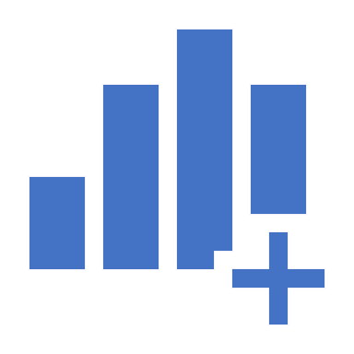
Chapter 2 Data Understanding

Slide 9
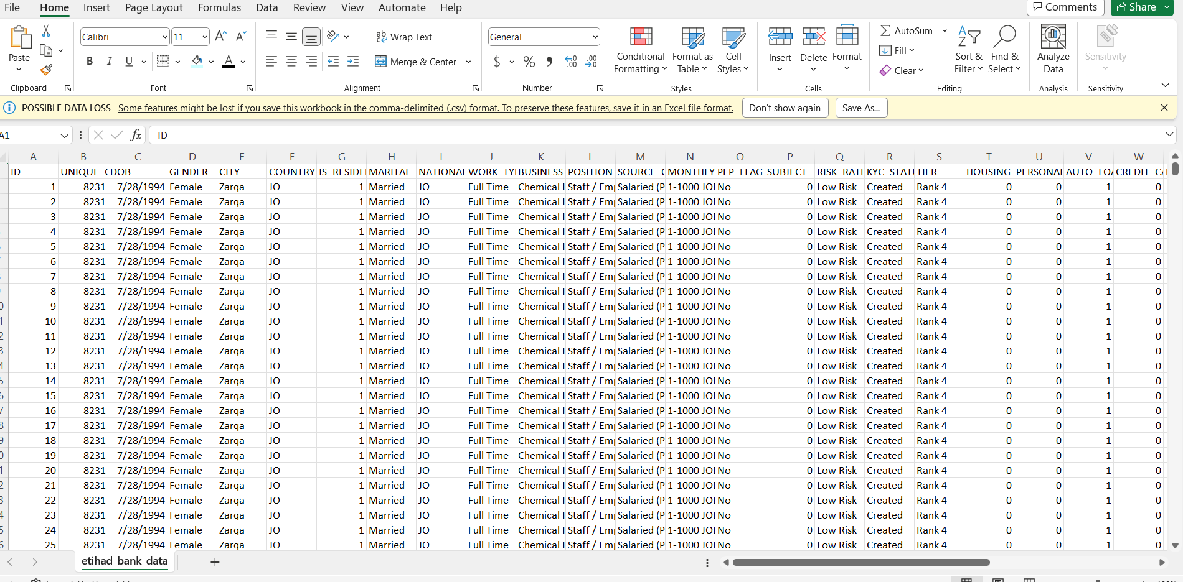
Step 1 Data Collection
Data is collected at this stage of the process via Etihad Bank-IT Department combining all customers transactions for 18 months starting at Jan 1st 2022, and is provided as a Comma-separated values (CSV) file.

Slide 10
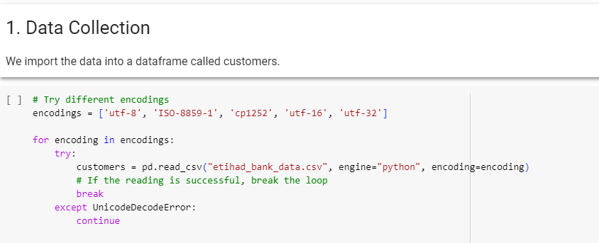
Step 2 Uploading
Next, the CSV file is uploaded to Python data frame structure and checked for proper reading

Slide 11
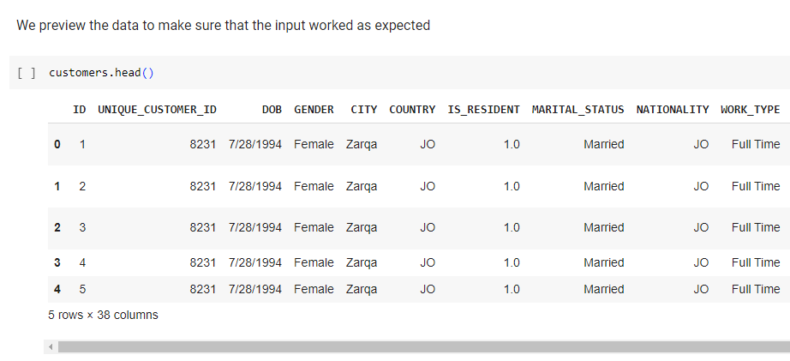
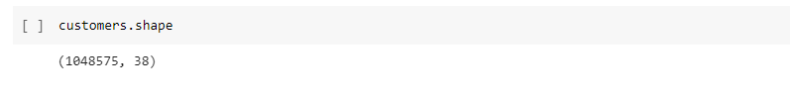
Step 3 Data preview
The number of records retrieved is 1,048,575 represented by 38 attributes:

Slide 12
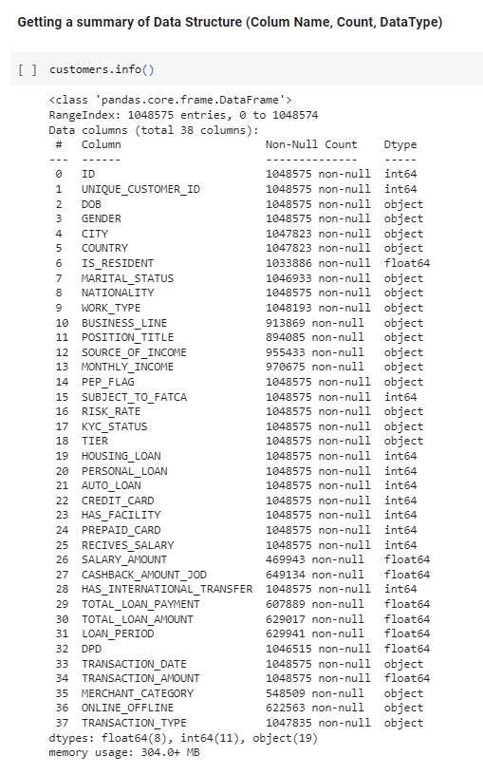
Step 4 Descriptive Statistics
Descriptive statistics are needed to be run against the data columns that would become variables in the model
Column names, non-null count and datatype are listed for all columns - as shown in the next figure:

Slide 13
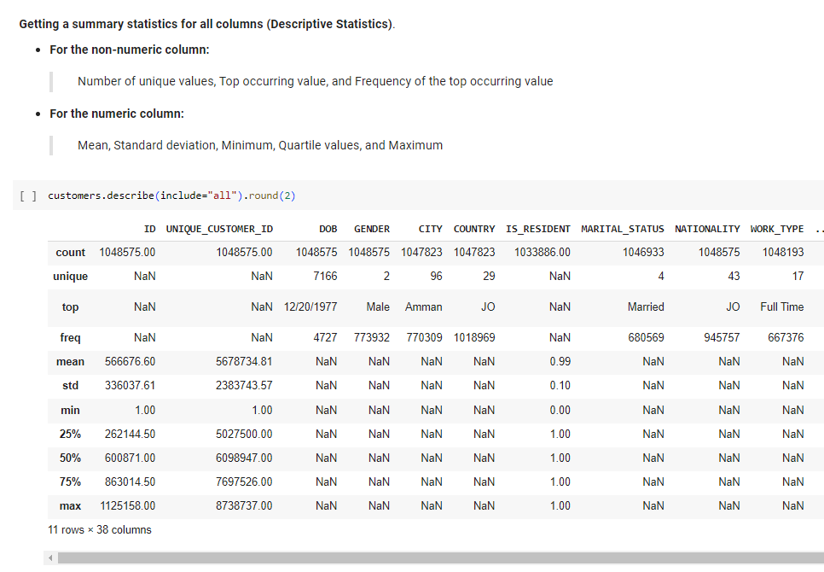
More data understanding

Slide 14
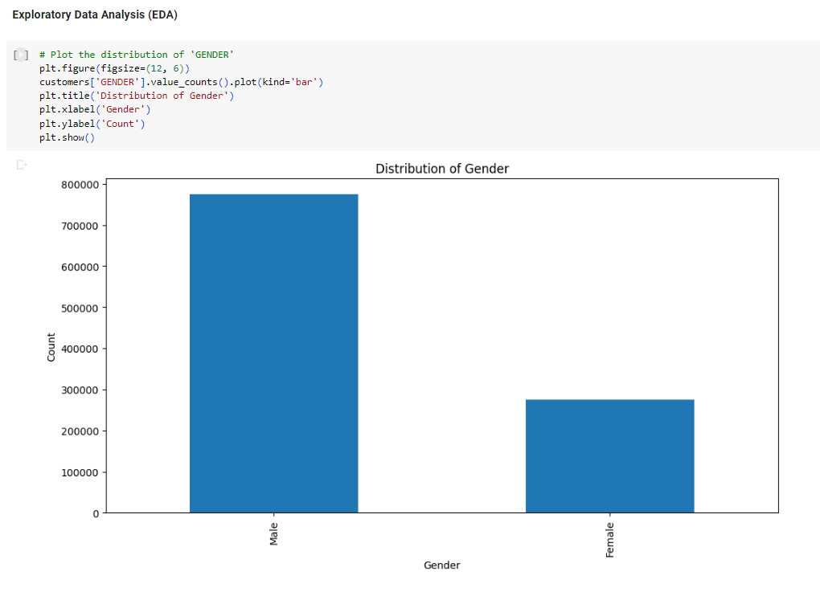
Step 5 Exploratory data analysis (EDA)
EDA is used to analyze and investigate data sets and summarize their main characteristics, often employing data visualization methods

Slide 15
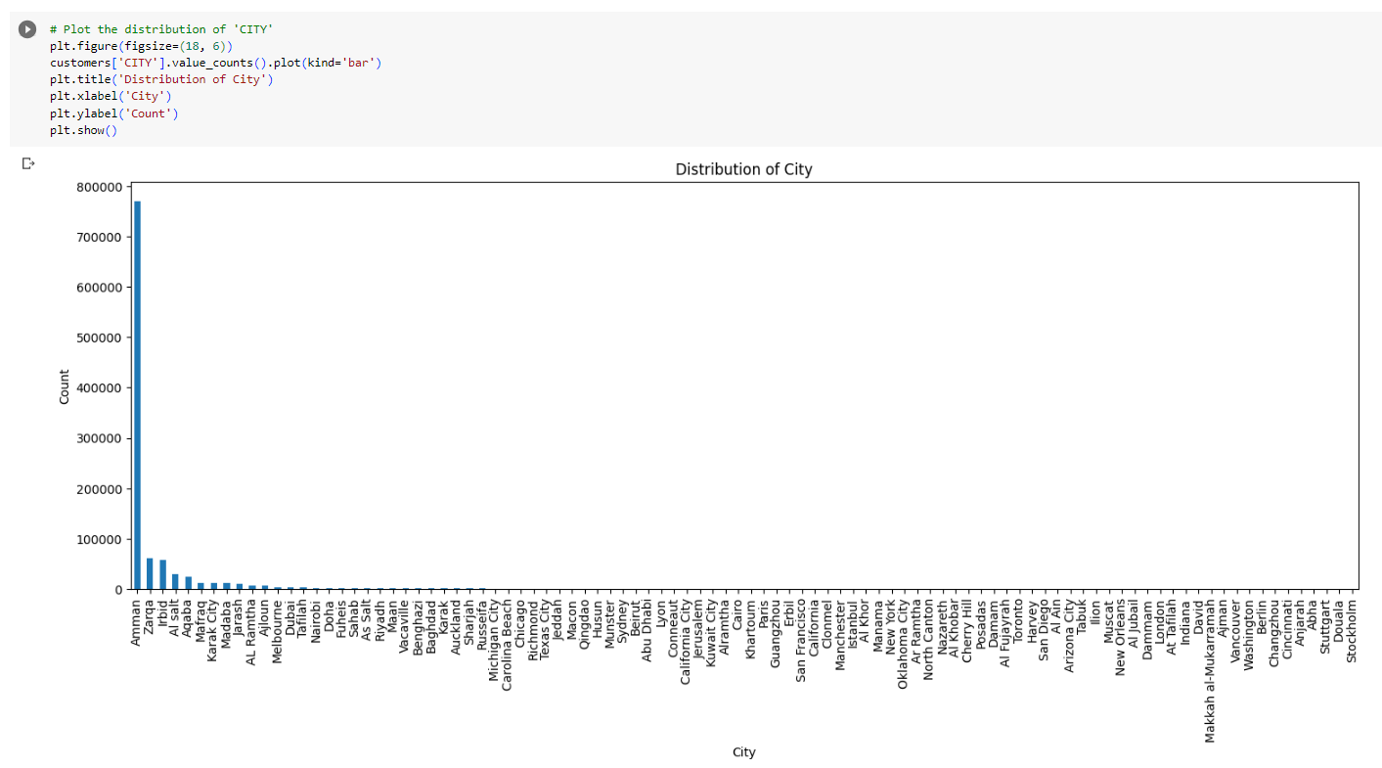
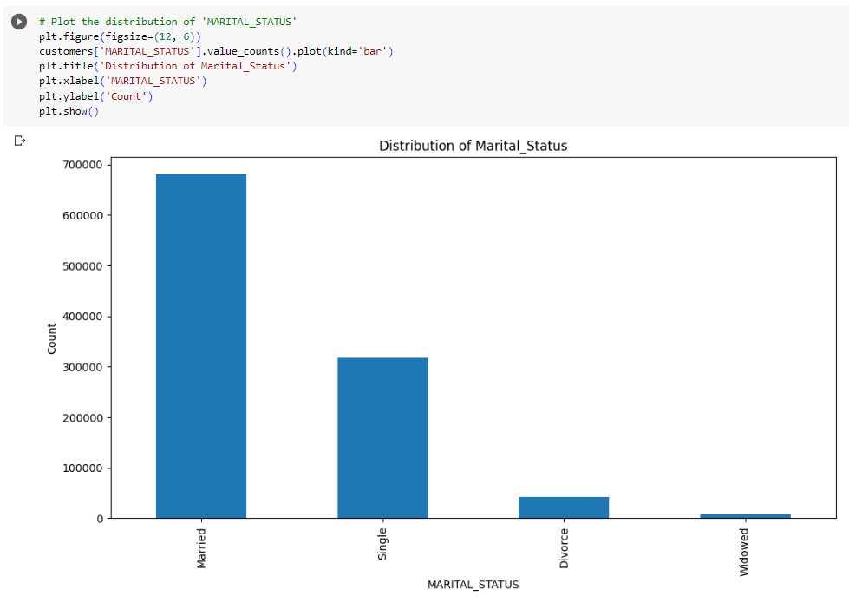

Slide 16
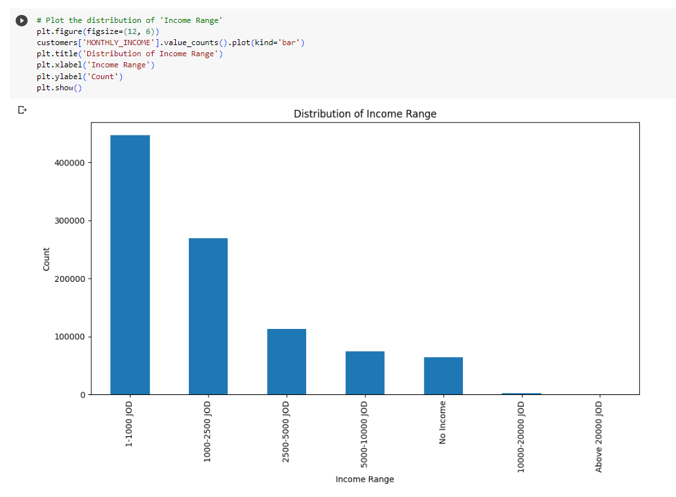
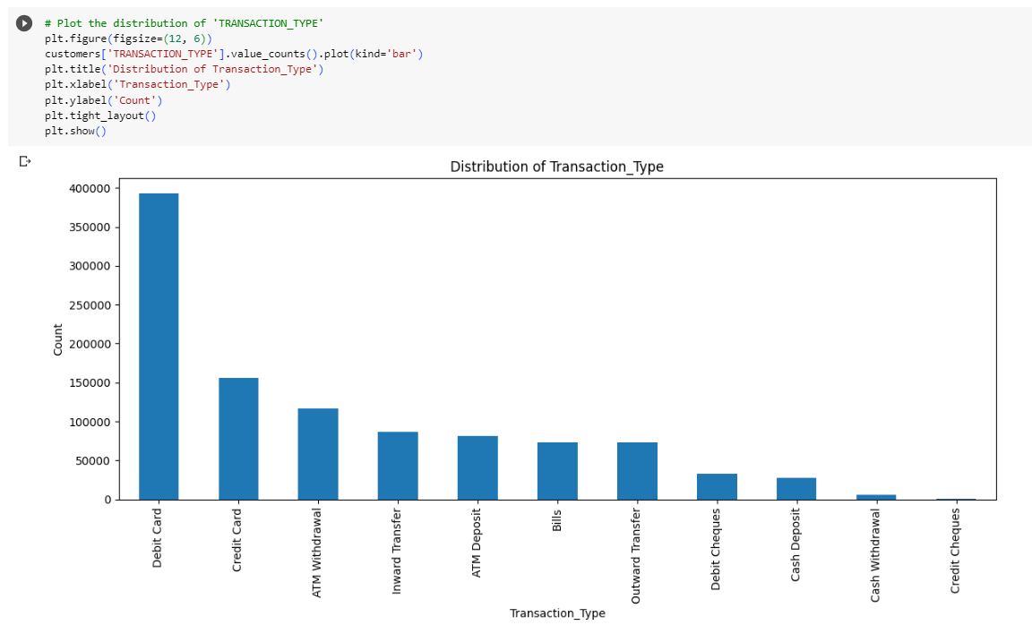

Slide 17
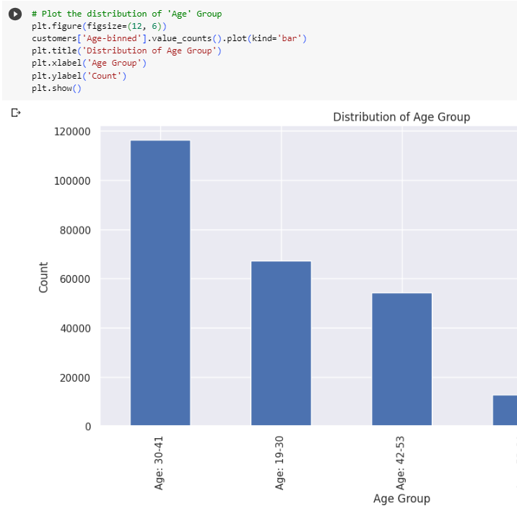
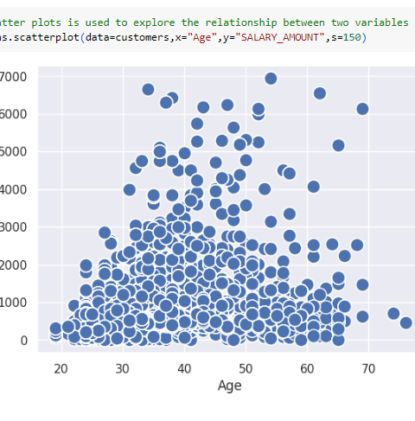

Slide 18
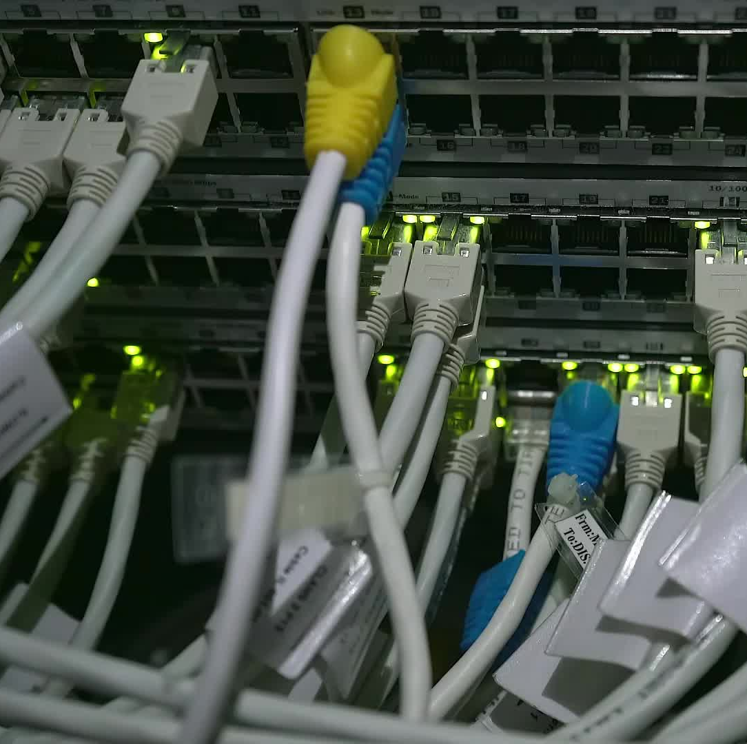
Chapter 3 Data Preparation
In this stage, it's important to make sure the data is able to be processed by the clustering model

Slide 19
5 steps for data preparation
Step 1: Handling missing values
1
Step 2: Outliers
2
Step 3: Handling incorrect Data types
3
Step 4: Creating new features
4
Step 5: Data normalization and scaling
5

Slide 20

Handling missing values
Missing values are represented as NaN, which is "Not a Number", most prediction methods cannot work with missing data, thus, we need to fix the problem of missing values.

Slide 21
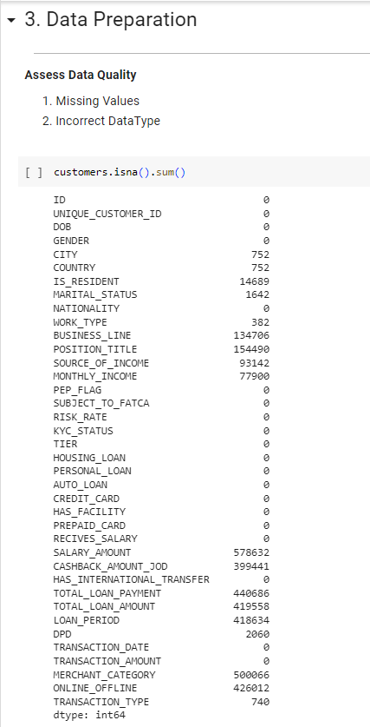
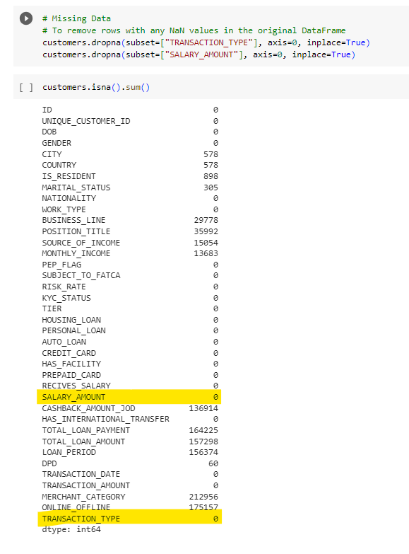

Slide 22
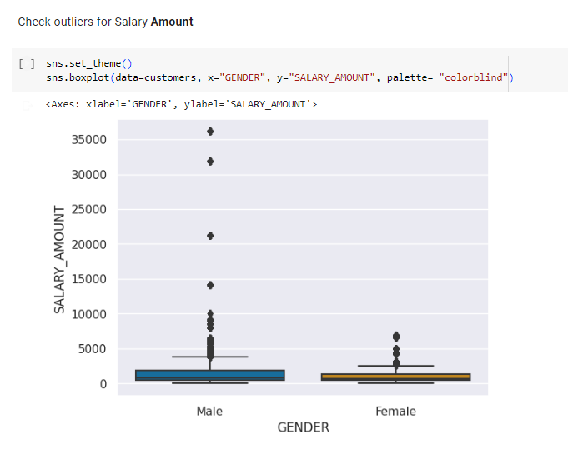
Outliers
There are ten customers who have Salary Amounts far a way from the normal, and considered outliers, those outliers are either errors: mistakes in the data or are unique, in all cases we need to remove those outliers to avoid impacting the Clustering Model

Slide 23
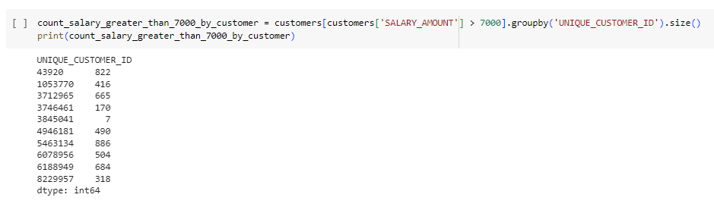
Solution for outliers

Slide 24
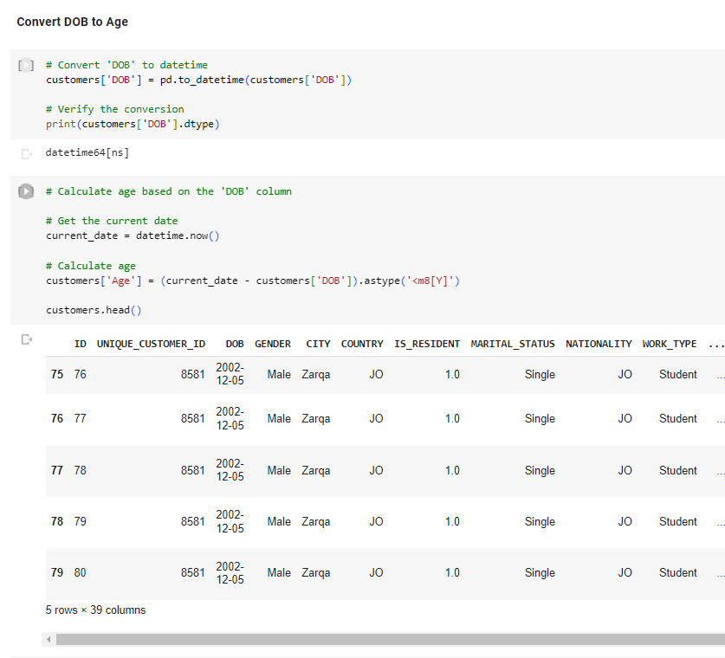
Handling incorrect data types
Converting the feature of DOB from object to datetime data type, and calculating the Age of the customer.

Slide 25
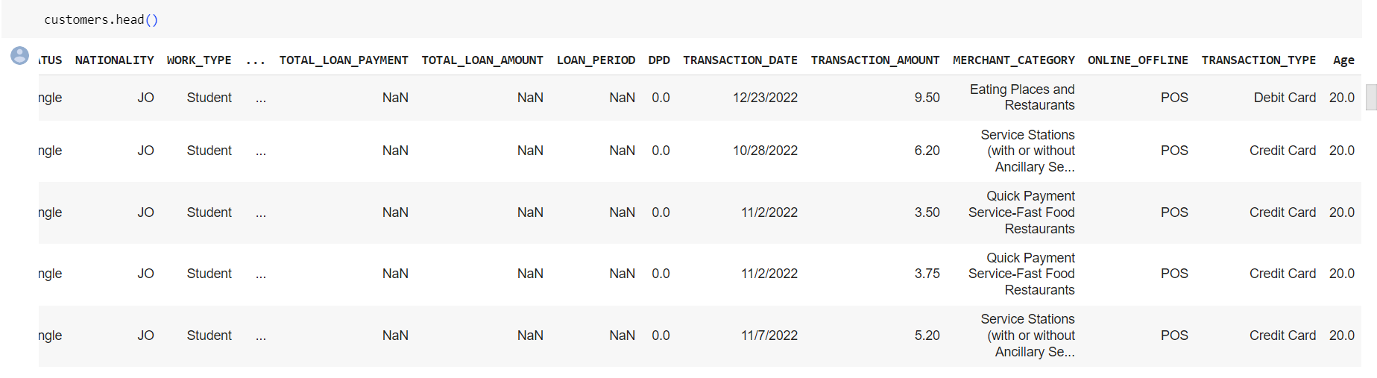

Slide 26
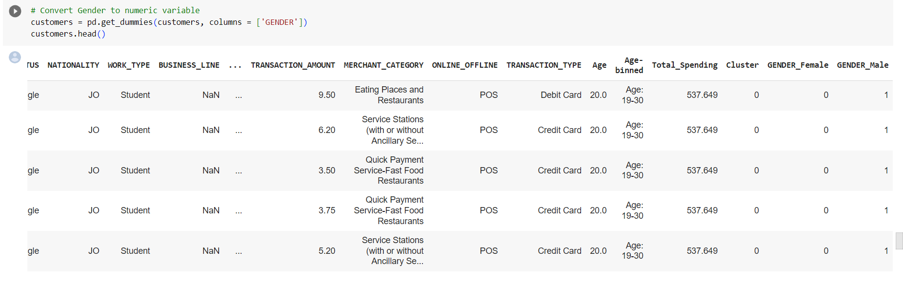

Slide 27
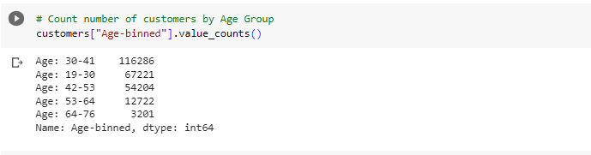
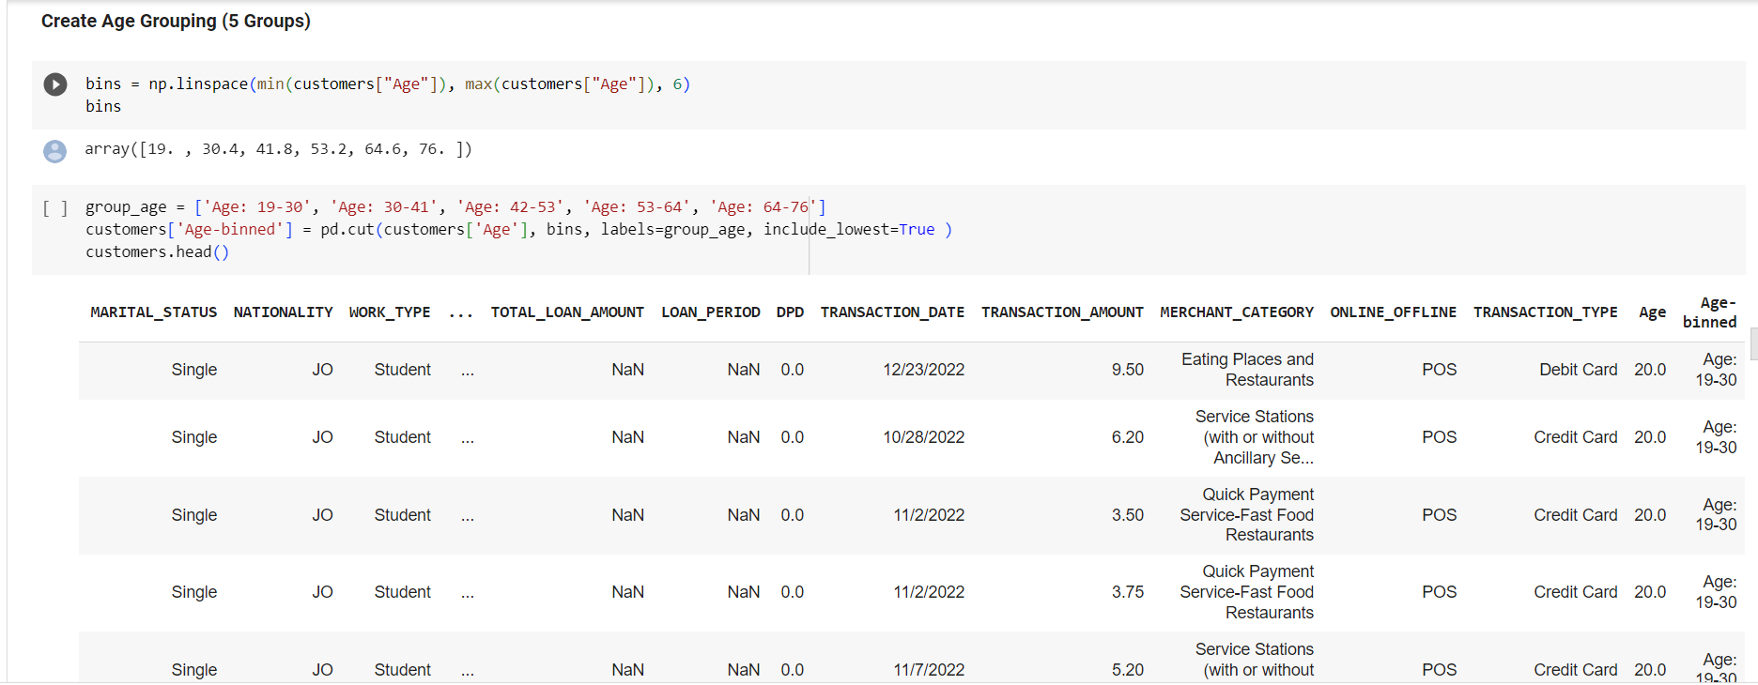
Creating new features

Slide 28
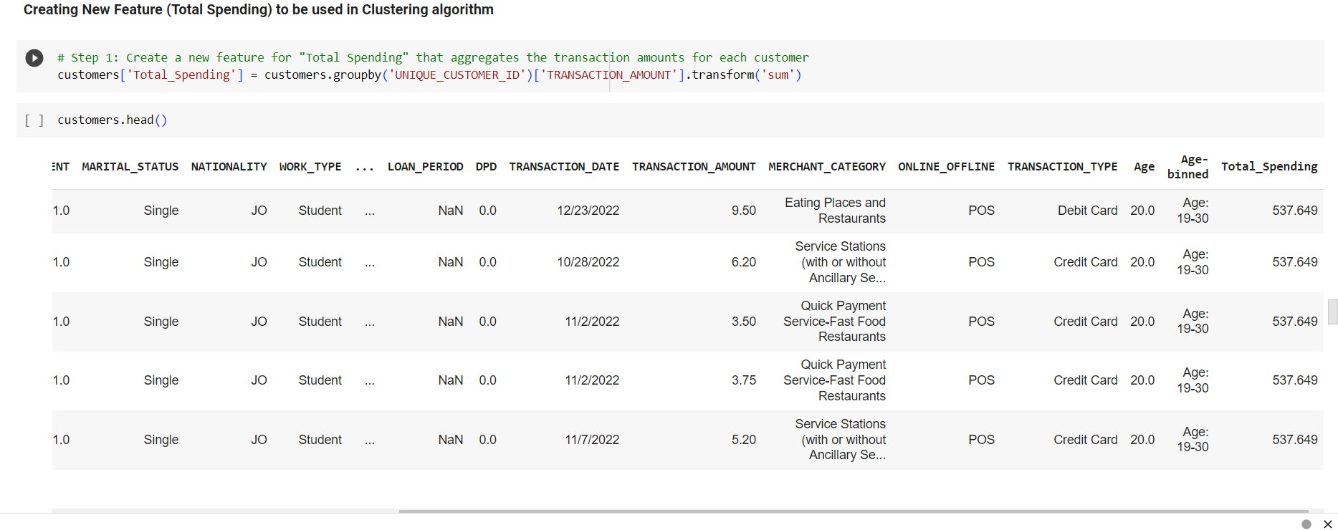
Total Spending is created as a new feature to be used in clustering algorithms. Total Spending is the summation of all transactions related to “Debit Card” and “Credit Card”

Slide 29
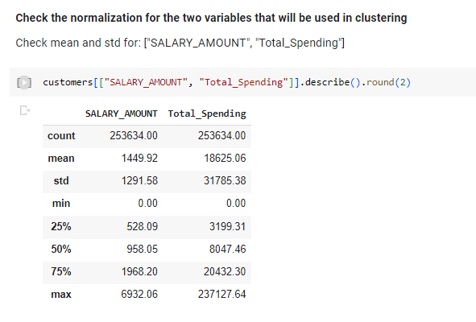
Data normalization and scaling
Transforming the data so that it fits within a specific scale, like 0-100 or 0-1. This is needed when using methods based on measures of how far apart data points are, like support vector machines (SVM) or k-nearest neighbors (KNN).

Slide 30

Problem
When we use K-means clustering to group similar things together, it measures how close or far apart they are. But sometimes, one thing can look closer just because it's bigger, not because it's actually more similar. Imagine you have data about how much people spend and how much they earn. If we use it as is, how much they spend will matter a lot, and how much they earn won't matter much.

Slide 31
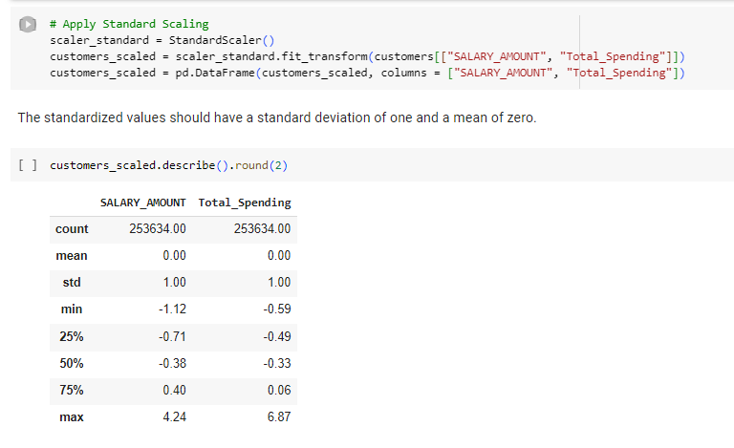
Solution
To fix this, we can make the numbers more fair by using something called "Z-score normalization." This makes both spending and earning count equally when we're figuring out how similar things are. It helps us cluster better!
As shown in the figure above, mean is Zero and the standard deviation is 1 meaning that proper scaling for the data has been conducted.

Slide 32
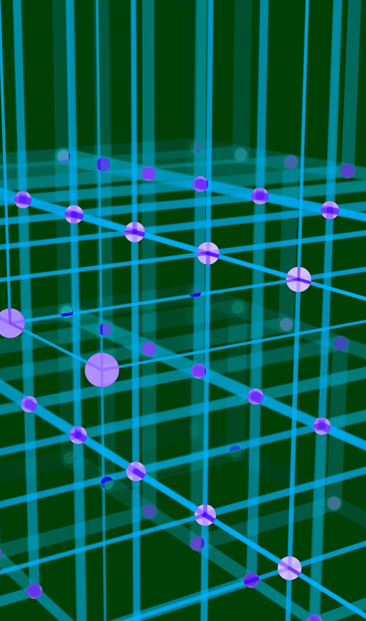
Chapter 4 Modeling

Slide 33
Clustering
Clustering is an approach in machine learning that is used to categorize or segment data into subgroups based on similarity. These subgroups are known as clusters. Clustering is an unsupervised machine learning approach.
Clustering is a widely used machine learning approach to segment customers for marketing purposes.

Slide 34
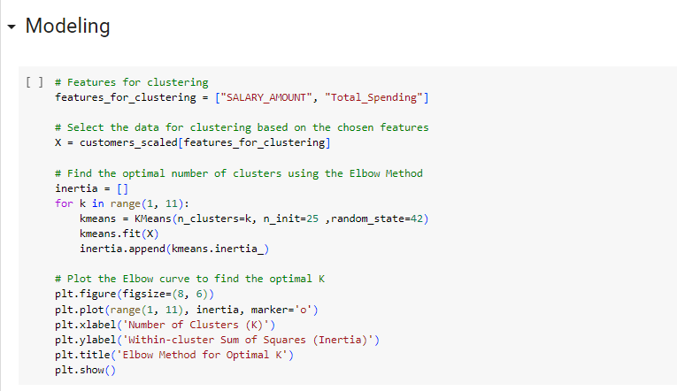
K-means clustering
One of the most used clustering techniques is known as K-Means clustering. This means that the cluster boundaries are independent of each other. Each item can only belong to one cluster and every item is assigned to a cluster.

Slide 35
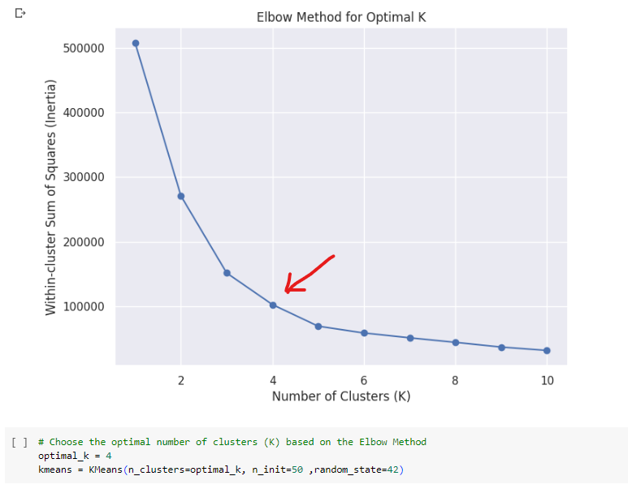
Elbow Method
One standard approach to choosing the value for K is the Elbow method. The elbow method randomly initializing K cluster centroids and iteratively adjusting them until they stop moving.

Slide 36
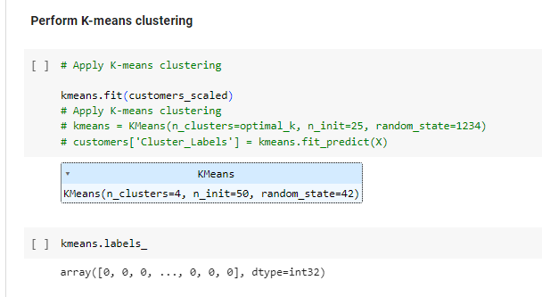
Based on Elbow Method, the optimal number of four clusters is calculated, then the algorithm is performed to assign every item within the dataset to one and only one of K non overlapping clusters based on similarity.

Slide 37

Chapter 5 Evaluation
In this stage of the methodology, model evaluation, deployment, and feedback loops to ensure that the answer to the business question is near and relevant.

Slide 38
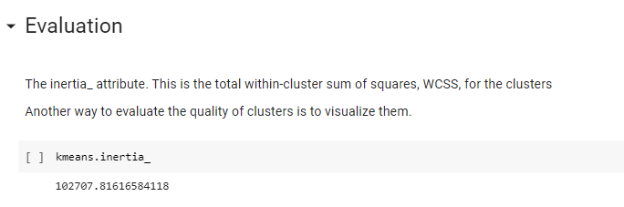
Kmeans.interia
In the context of the K-means clustering algorithm in machine learning, the kmeans.inertia_ attribute refers to the sum of squared distances between each data point and the centroid of its assigned cluster. This attribute is a measure of how well the data points within each cluster are grouped around their centroids.

Slide 39
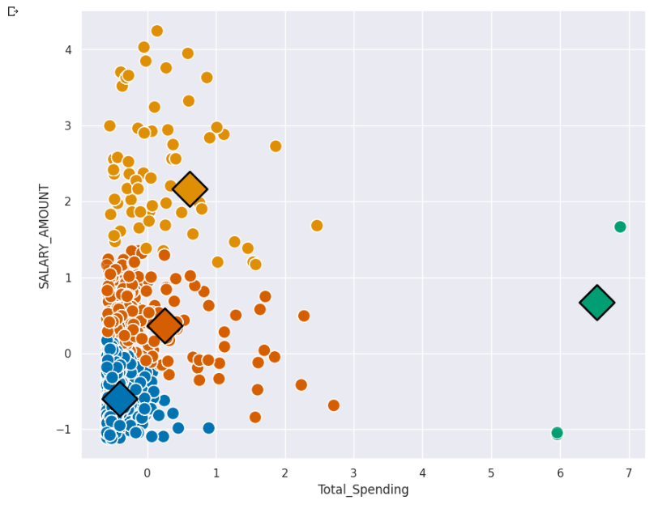
Cluster centroids
Cluster centroids are the representative points of a cluster in a clustering algorithm. These centroids play a crucial role in defining the clusters and are used to determine the cluster assignments of data points.

Slide 40
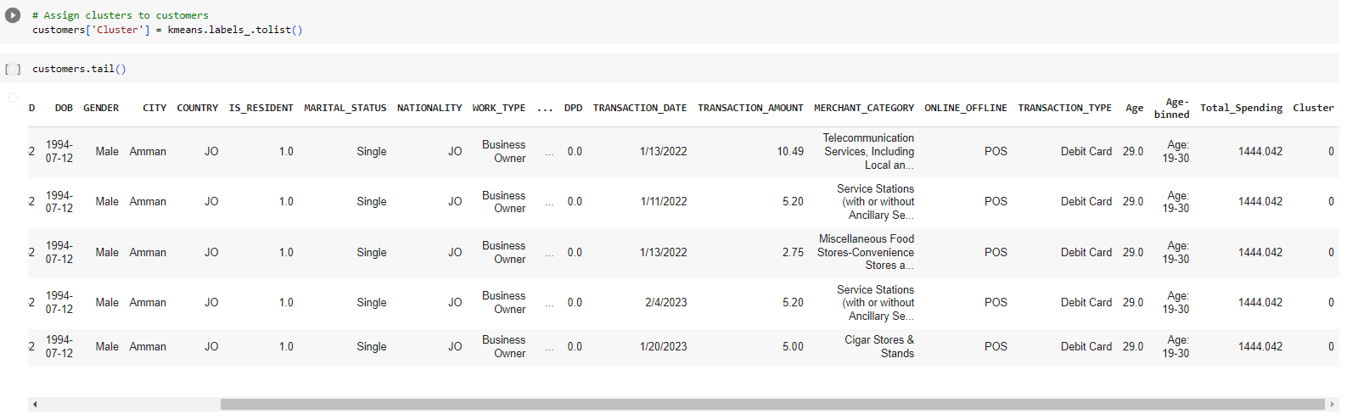
Assigning
Now we've segmented our data into four clusters, we can assign the cluster numbers to each of the customers in the original data and analyze the characteristics of each segment.

Slide 41
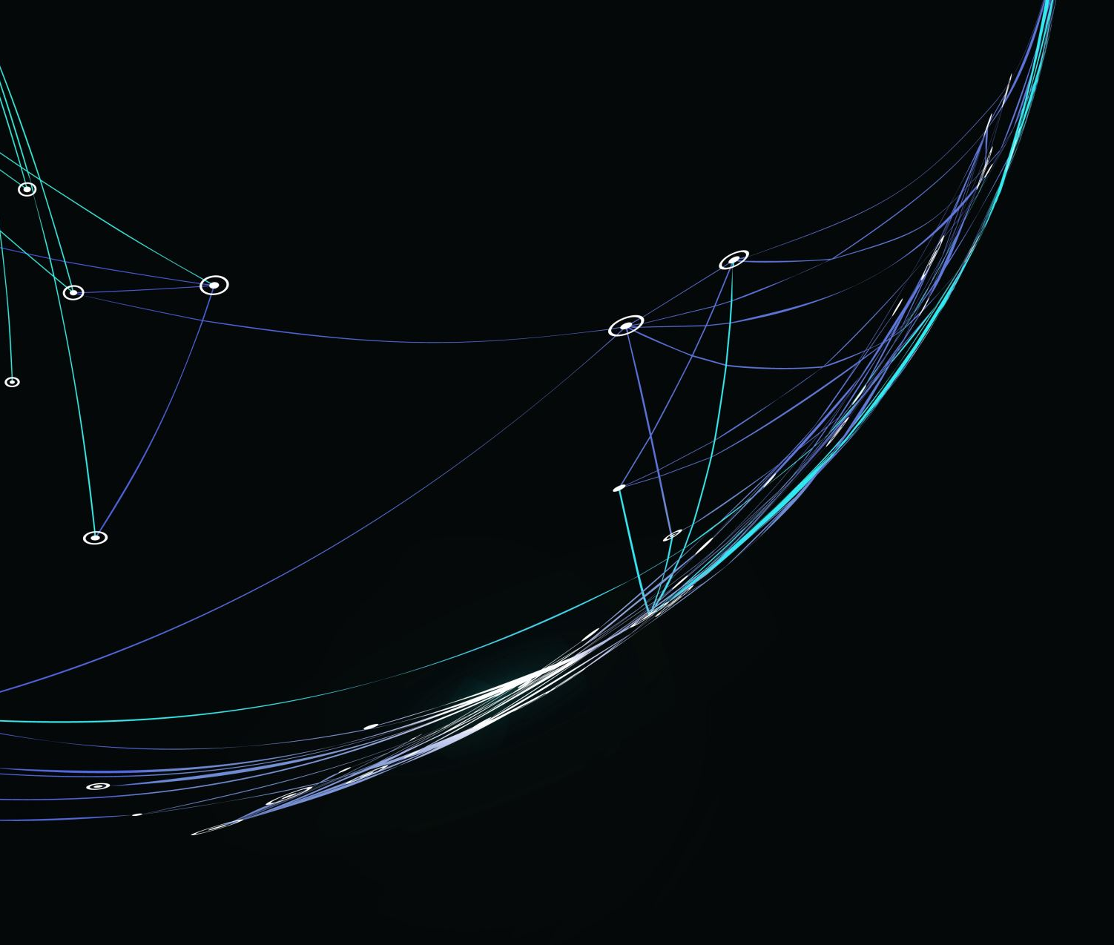
Chapter 6 Insights for Customers

Slide 42
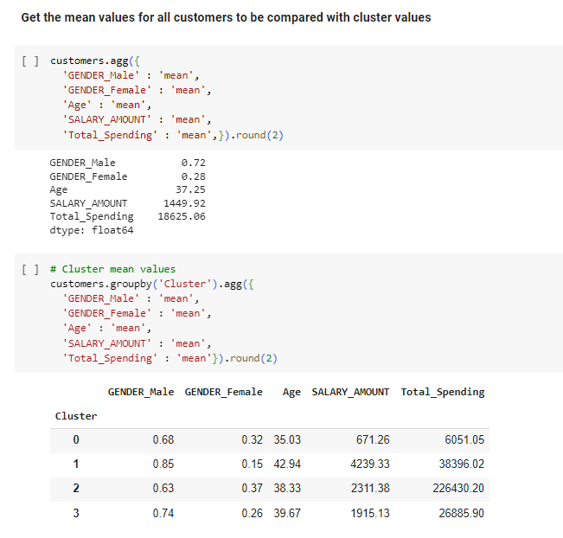
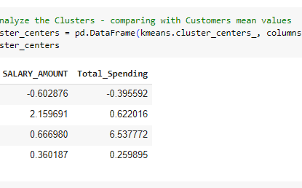
Actionable Insights
To get actionable insights, we need first to get descriptive statistics for the features used in segmentation for the whole customer dataset and compare it with the descriptive statistics by clusters.

Slide 43
Insights for customer relation strategies
Feature Mean | All Customers | Cluster 0 | Cluster 1 | Cluster 2 | Cluster 3
Male | 72% | 68% | 85% | 63% | 74%
Female | 28% | 32% | 15% | 37% | 26%
Age | 37.25 | 35.03 | 42.94 | 38.33 | 39.67
Salary Amount | 1449.92 | 671.26 | 4239.33 | 2311.38 | 1915.13
Total Spending | 18625.06 | 6051.05 | 38396.02 | 226430.20 | 26885.90

Slide 44
Continuation
Cluster 0:
Volume = 152573
Representation of men is less than the average
Representation of women is higher than the average
Customers are slightly younger than average
Customers earn less and spend less than the average
Suggested Strategy - keep a watchful eye on the low earning low spending customers
Cluster 1:
Volume = 30259
Representation of men is higher than the average
Representation of women is less than the average
Customers tend to be older than the average
Customers earn and spend more than the average
Suggested Strategy - it would make sense to invest in increasing the spending of the high earning in this cluster
Cluster 2:
Volume = 3685
Representation of men is less than the average
Representation of women is higher than the average
Customers earn and spend more than the average
Suggested Strategy - it would make sense to keep the high spending customers in this cluster too happy & devote more time and attention to retaining these customers.
Cluster 3:
Volume = 67117
Customers mimic the gender distribution of the entire dataset
Customers earn and spend more than the average
Suggested Strategy -it would make sense to invest in increasing the spending in this cluster.

Slide 45
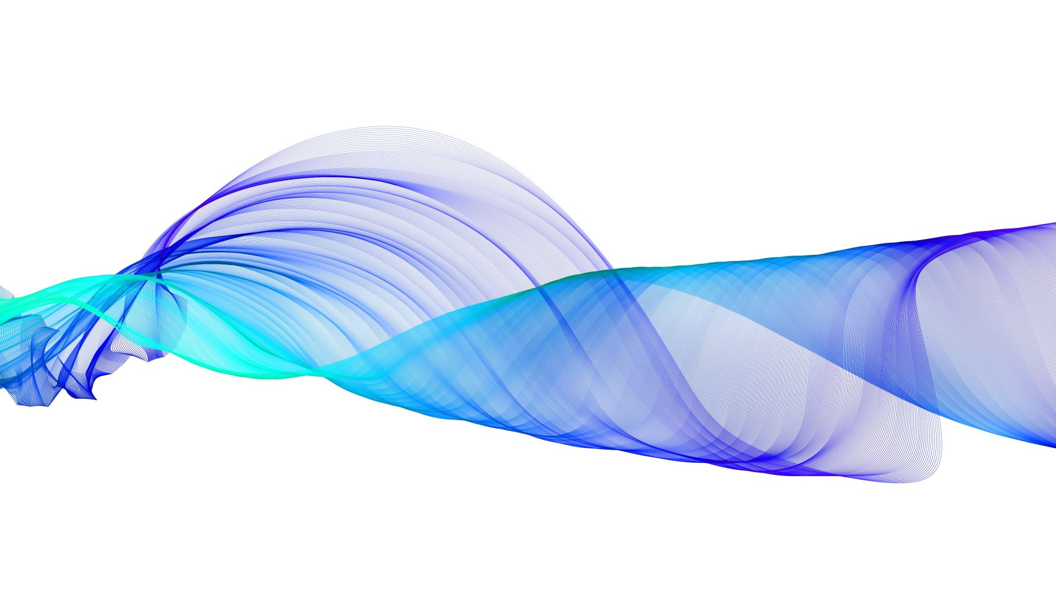
Chapter 7 Conclusion and Future

Slide 46
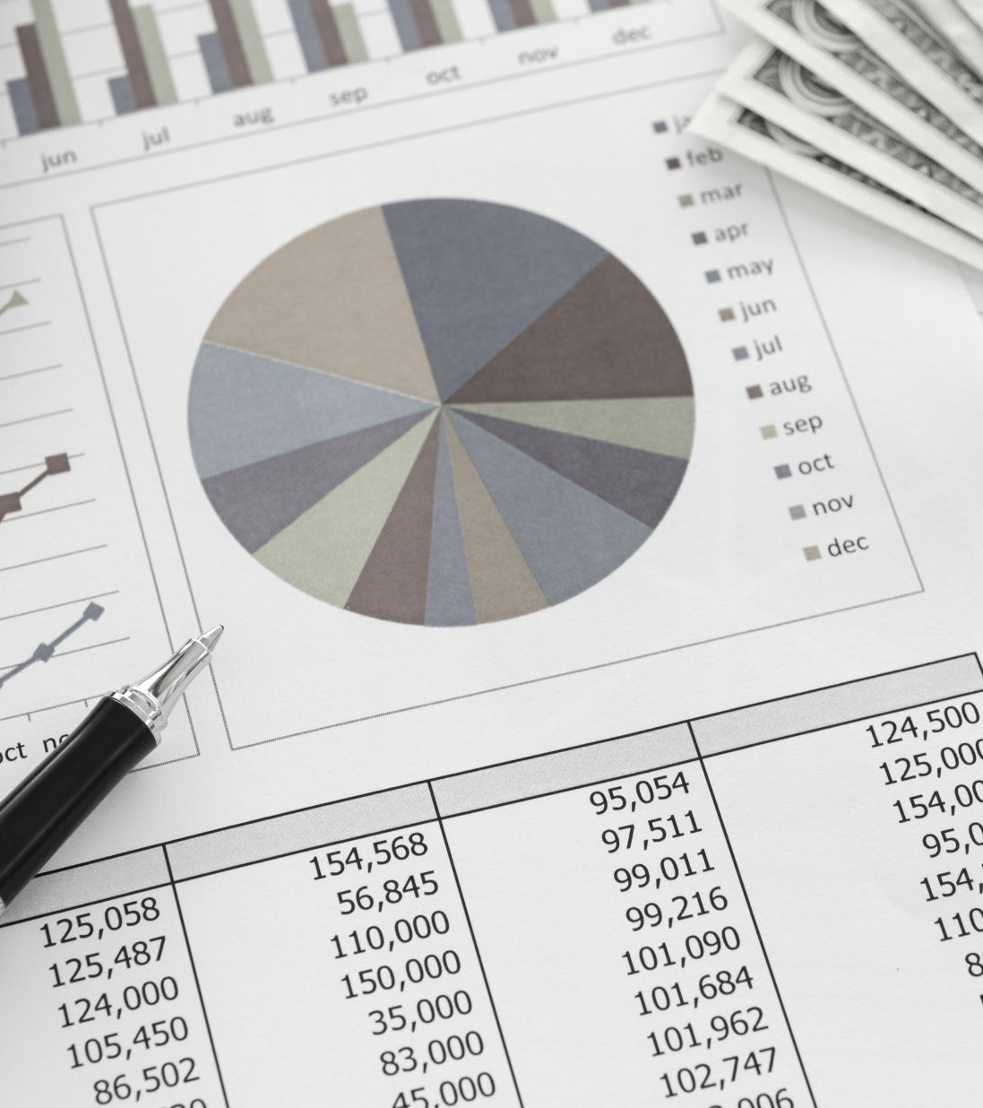
Conclusion
As a result of this study, four partitional clusters were generated representing different income earning and total spending means with actionable insights.
Etihad Bank can join this segmented dataset with the dataset of the product or services they offer. Having this information would allow the bank to develop highly personalized experiences for each segment.

Slide 47
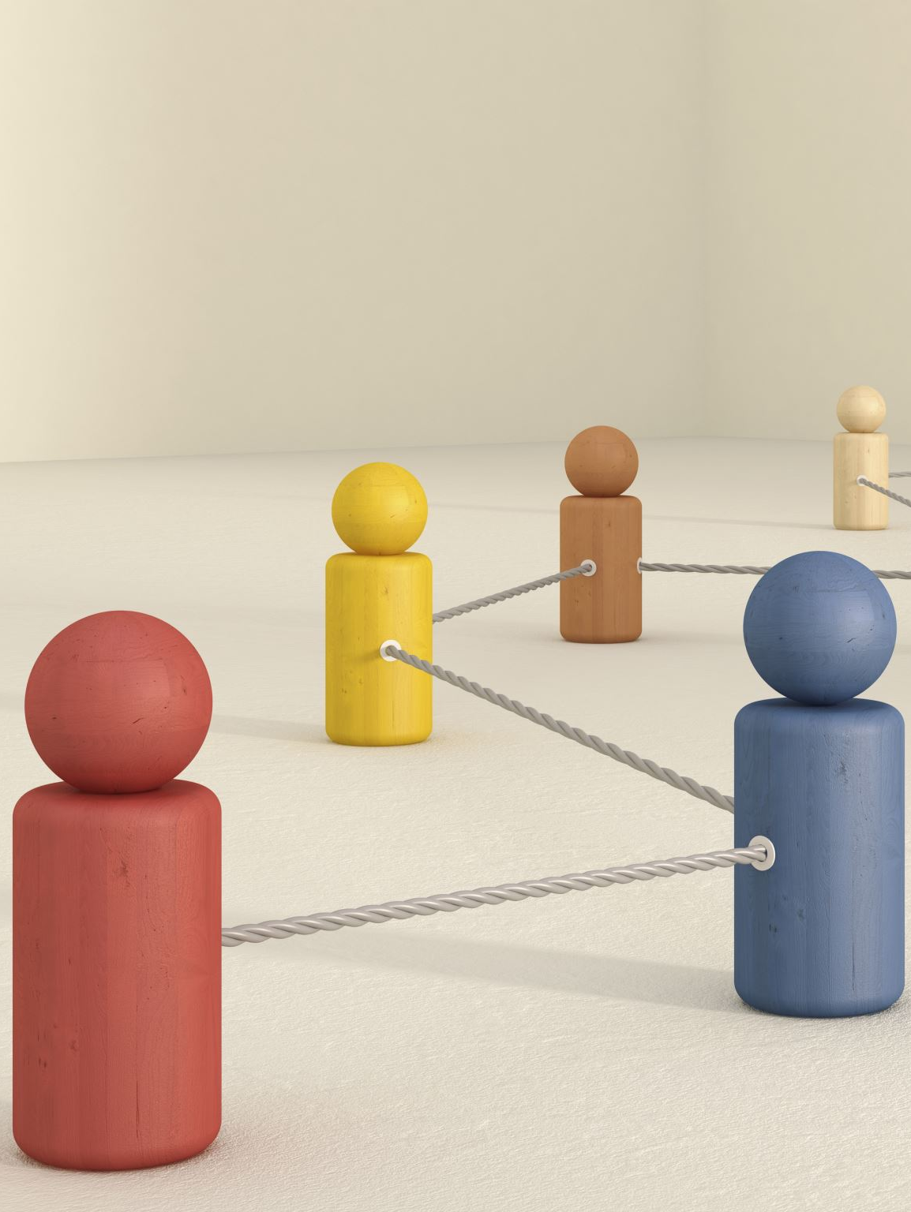
Future
Initial deployment and feedback (Etihad Bank)
Feedback from Etihad Bank will help to refine the model and assess it for better performance and impact.
Finally, the refined model and intervention actions would be redeployed, with the feedback process continued throughout the life of the program.

Slide 48
Thank you

